Slide 1


2019 MEDIA KIT

Slide 2
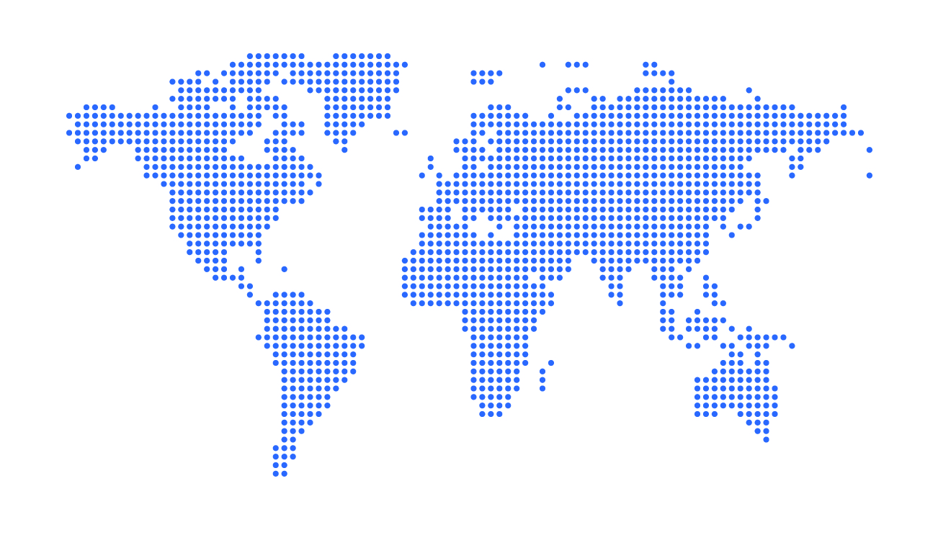


27
3
YEARS OF EXPERIENCE
COMPANIES
With 27 years of experience and a member of CVC Corp, GRUPO TREND has the most cutting-edge tools of the market in its portfolio, exclusively developed to travel agents and partners.

Slide 3



Benchmark for the national and international Travel and Tourism industry, with a complete portfolio focusing on Business and Leisure
Competitive rates for hotels in Brazil and abroad with 100% on-line service
GRUPO TREND + VHC: portfolio with more than 300 houses for rent in Florida

Slide 4

NUMBERS
+500,000
+5million
+14,000
hotels in Brazil and abroad
of room nights sold
travel agencies served
  Data from 2019

Slide 5




Internal communication
Segue Viagem
Digital
Events
Other activities
Print magazine
SV Digital
Social media
YouTube channel
Banner
Push message
TREND Courses
E-mail marketing
Trade: Panrotas and Mercado&Eventos
Sales Convention
Friends of TREND
Agent Training
Employee engagement activities
Incentive Campaigns
Trade fairs
Sales blitz
Themed Weeks
Workshops
FAM Tours
Sales Campaigns
VHC Stay Home Magazine
MKT by TREND
  Intranet – interactive platform that communicates straightly to all areas of the company

Slide 6


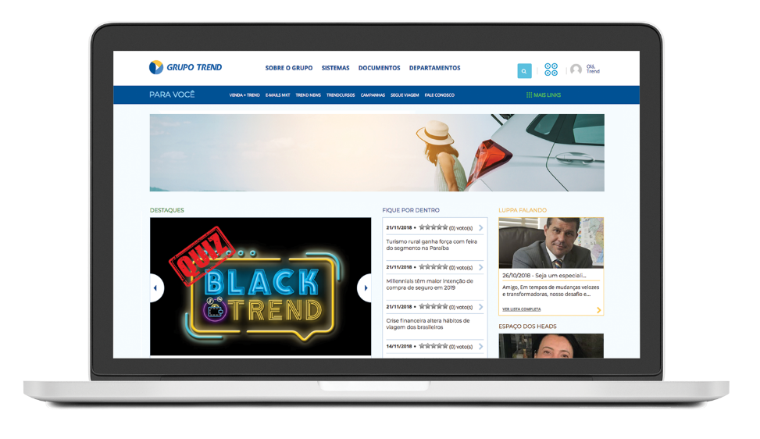
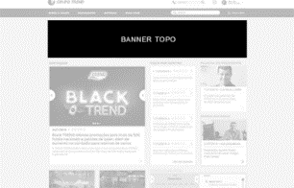
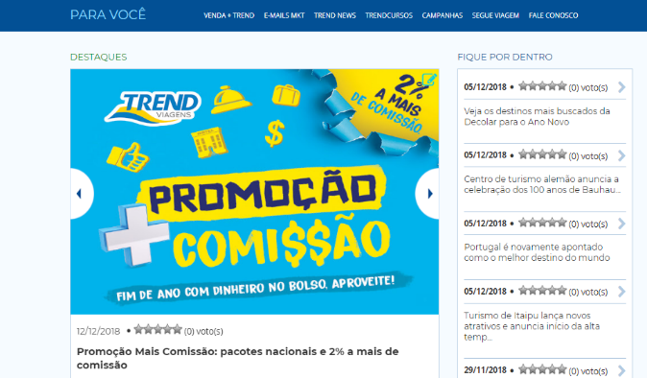

INTRANET
Everything that employees need to know in one place: campaigns, offers, exclusive rates, bulletins and more.
Top Banner
Footer

Slide 7
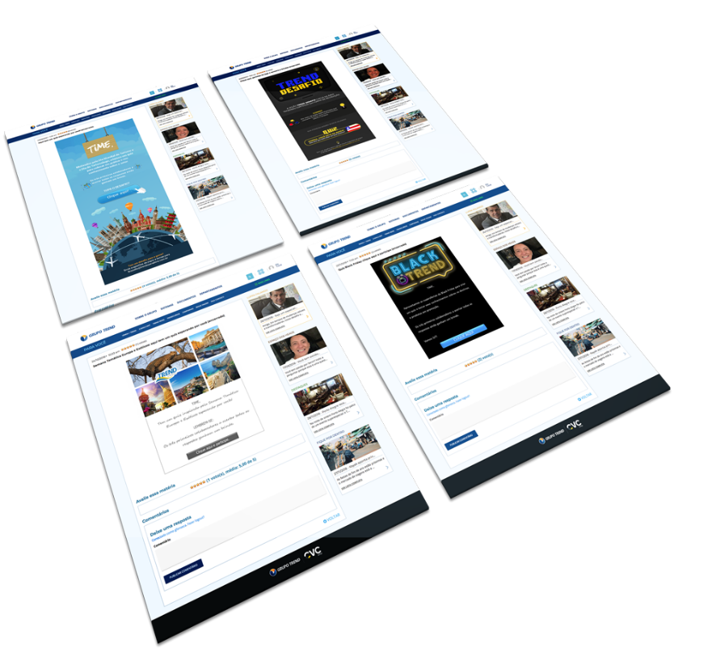

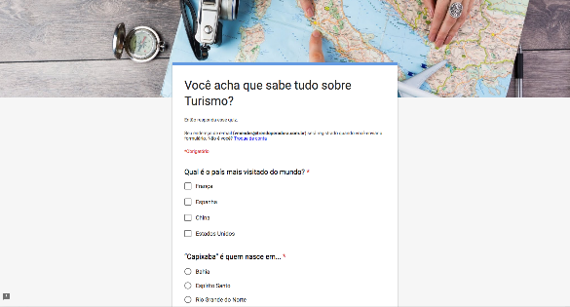
INTRANET - QUIZ
Created to promote knowledge through games.
Developed in parallel with business activities, such as Themed Weeks or to highlight some specific product.

Slide 8

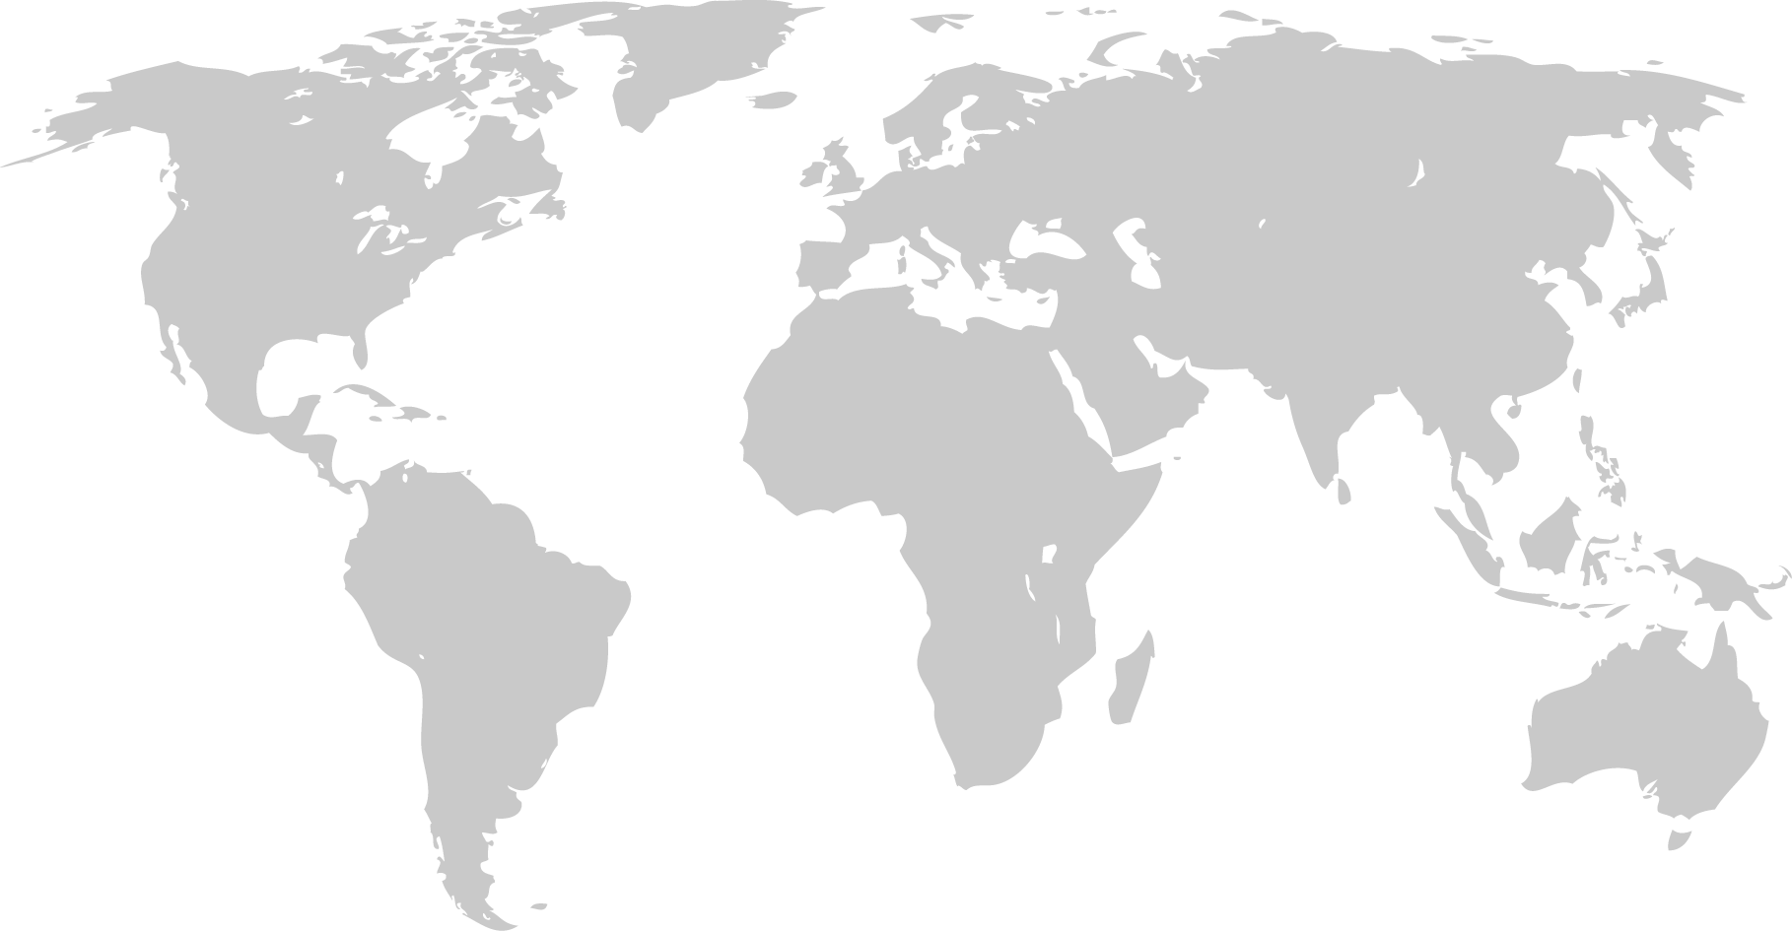
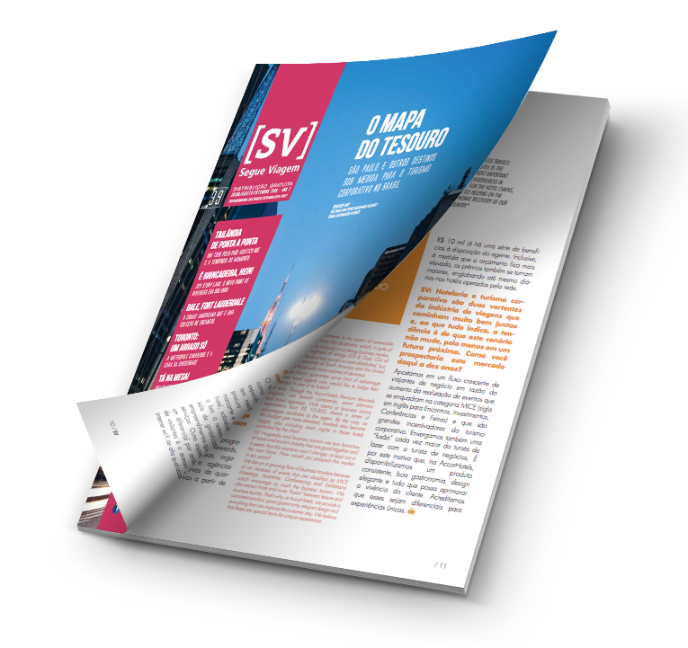


SEGUE VIAGEM MAGAZINE
Print magazine that brings to its audience the main trends of the Tourism and Travel industry in Brazil and abroad through bilingual content (Portuguese/English), also available at www.segueviagem.com.br and apps at Apple Store and Google Play (Segue Viagem). Articles are also posted on social media.
+10,000
copies
Published on a quarterly basis

Slide 9
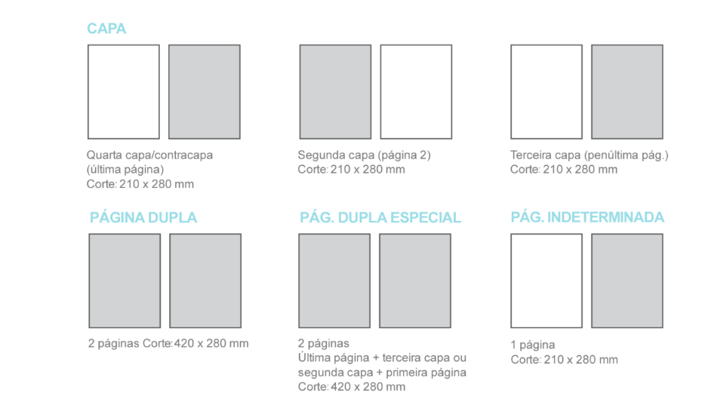

COVER AD
Fourth cover/inside cover (last page)
Size: 210 x 280 mm
Second cover ad (page 2)
Size: 210 x 280 mm
Third cover ad (next-to-last page)
Size: 210 x 280 mm
DOUBLE-PAGE AD
2 pages Size: 420 x 280 mm
SPECIAL DOUBLE-PAGE AD
2 pages
Last page + third cover or second cover + first page
Size: 420 x 280 mm
INDETERMINED PAGE
1 page
Size: 210 x 280 mm
SEGUE VIAGEM MAGAZINE - ADS

Slide 10
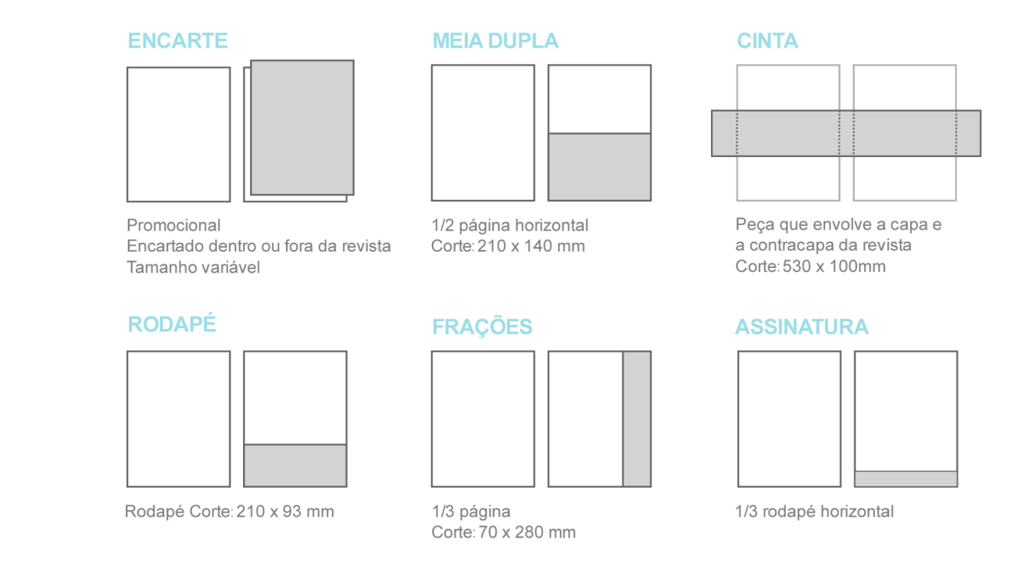
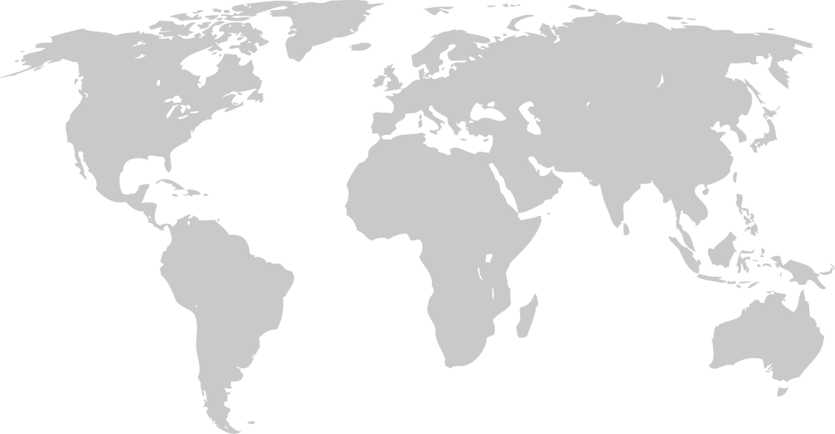
PULLOUT
Promotional
Pullout inside or outside the magazine
Variable size
DOUBLE HALF-PAGE
½ horizontal page
Size: 210 x 140 mm
BANNER
Banner ad around the magazine
Size: 530 x 100 mm
FOOTER
Footer
Size: 210 x 93 mm
VERTICAL
1/3 page
Size: 70 x 280 mm
SIGNATURE
1/3 horizontal footer
SEGUE VIAGEM MAGAZINE - ADS

Slide 11
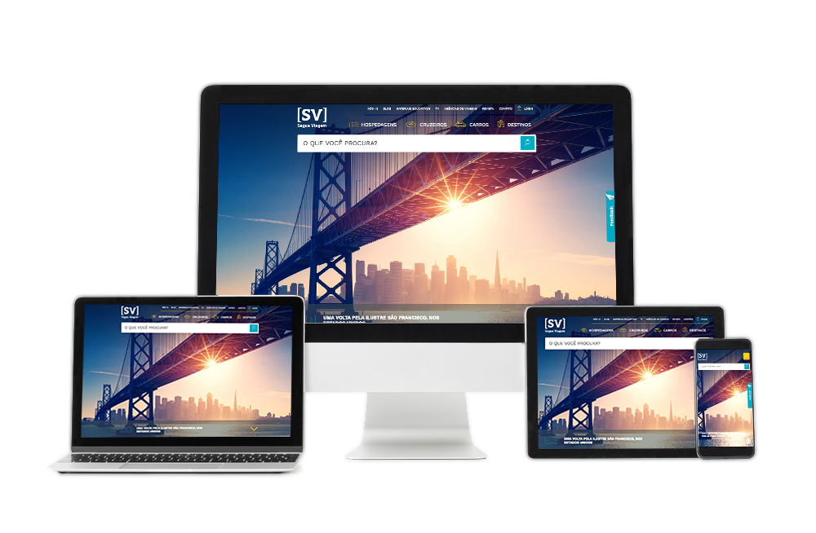
SEGUE VIAGEM DIGITAL
Web portal that brings information and entertainment to tourism professionals and travelers. Content includes more than 1,600 hotels in Brazil and abroad, travel blog, travel guides, exclusive videos and products like house rental in Florida, cruises and car rental.
185.000
Visitors/month
213.000
Pageviews/month
1,25
Pages per session
01:46
Average session duration

Slide 12
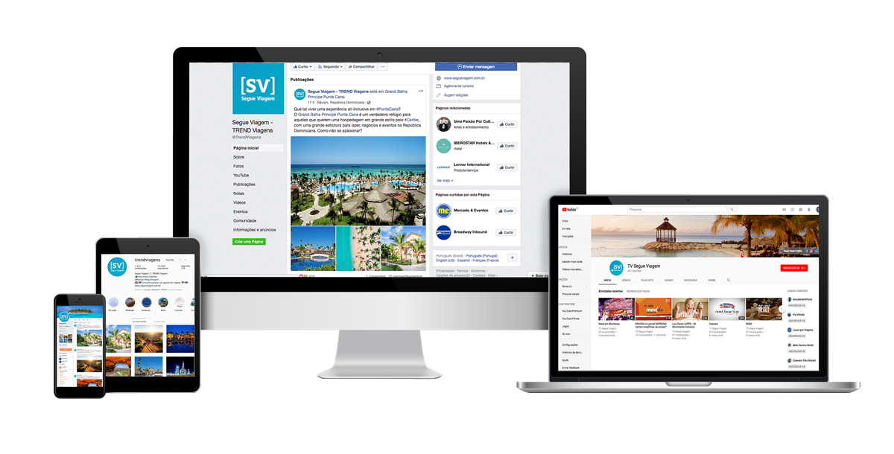
SOCIAL MEDIA
An exclusive themed week to promote the destination or product on Facebook, Instagram and Twitter.
+430,000
Facebook:
followers
+100,000
Instagram:
Users reached/
month
+15,000
Twitter:
Users reached/month
+80
YouTube:
videos

Slide 13
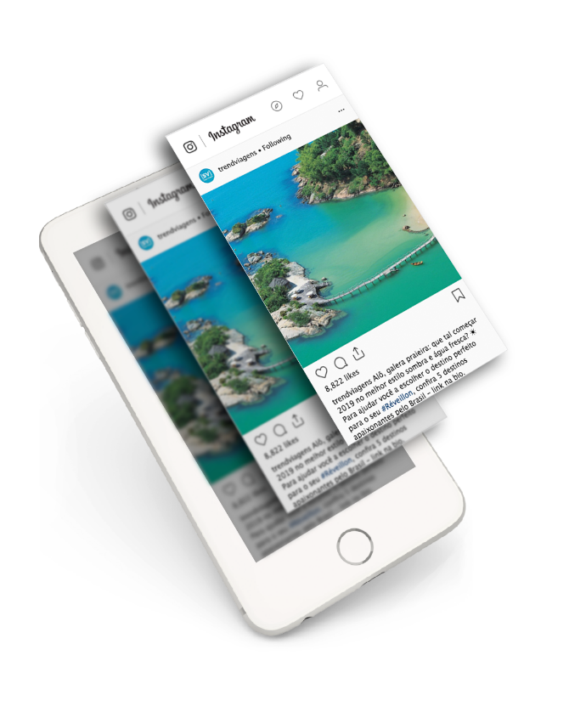
SOCIAL MEDIA – INSTAGRAM
Most liked post:
+8,800
Likes
+20.000
Users reached

Slide 14
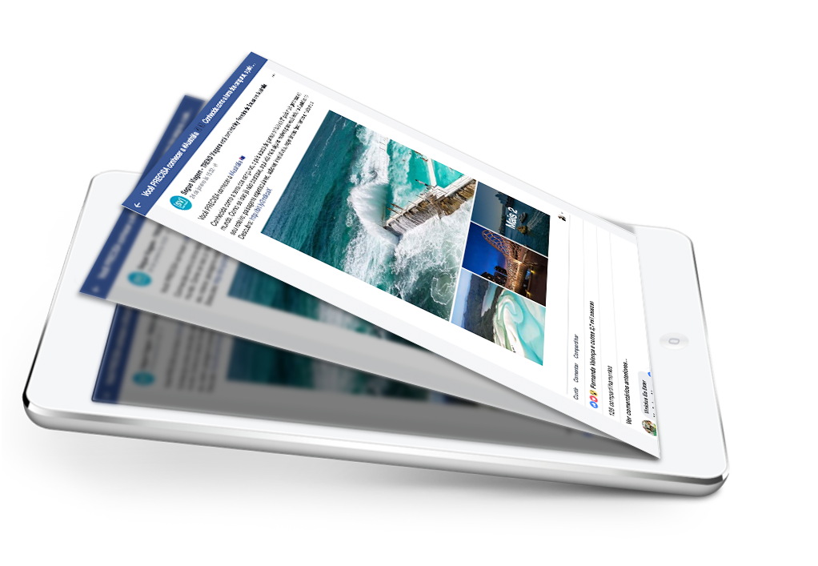
SOCIAL MEDIA – FACEBOOK
Most commented post:
+3,300
Likes
+212.000
Users reached

Slide 15


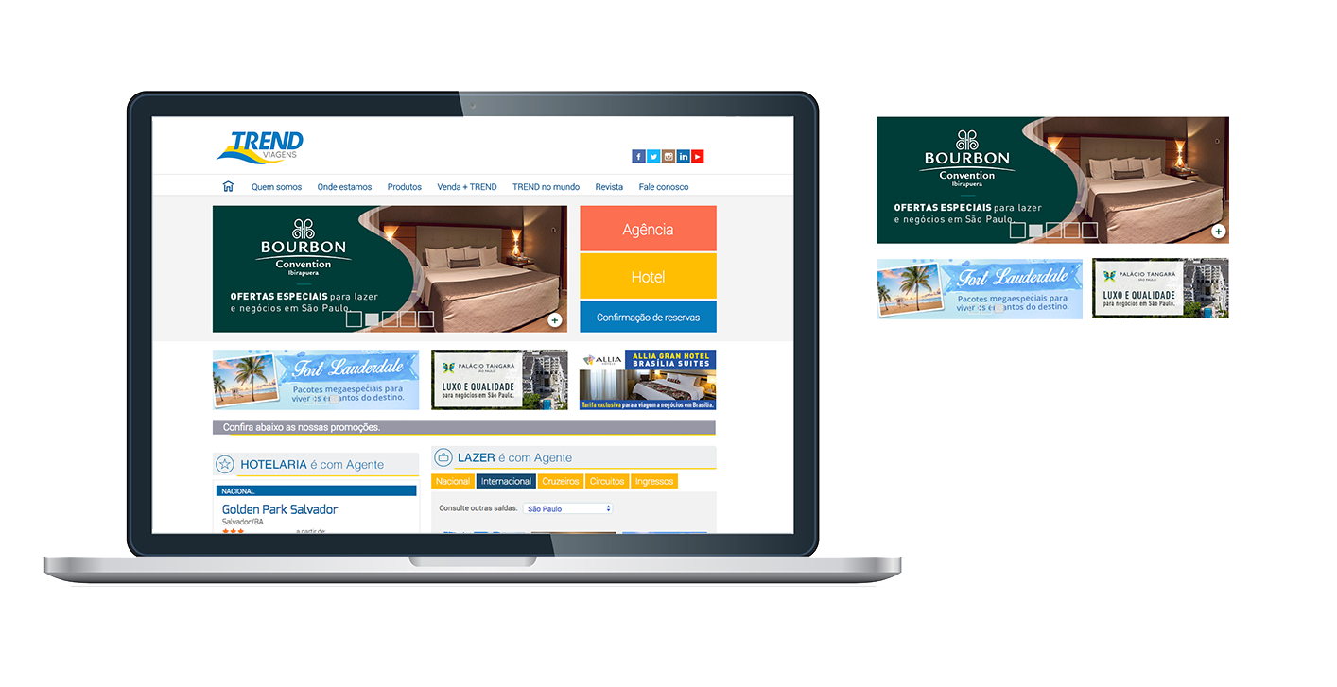
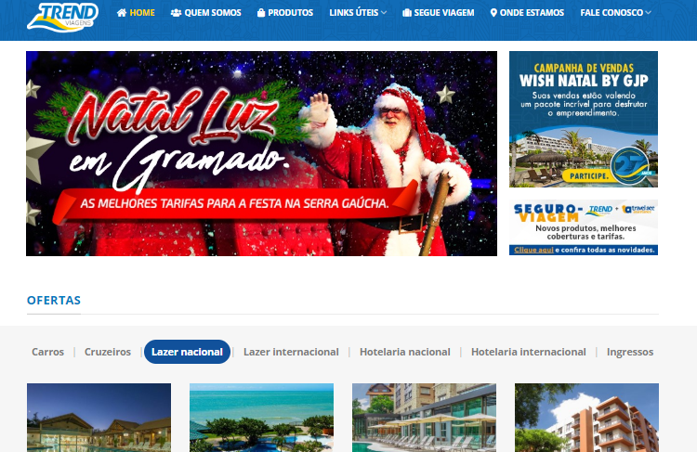
TREND VIAGENS – BANNERS
Banner 1
Banner 2
Banner 3
270.000
Visitors/month
290.000
Pageviews/month
5,54
Pages per session
08:32
Average session duration

Slide 16
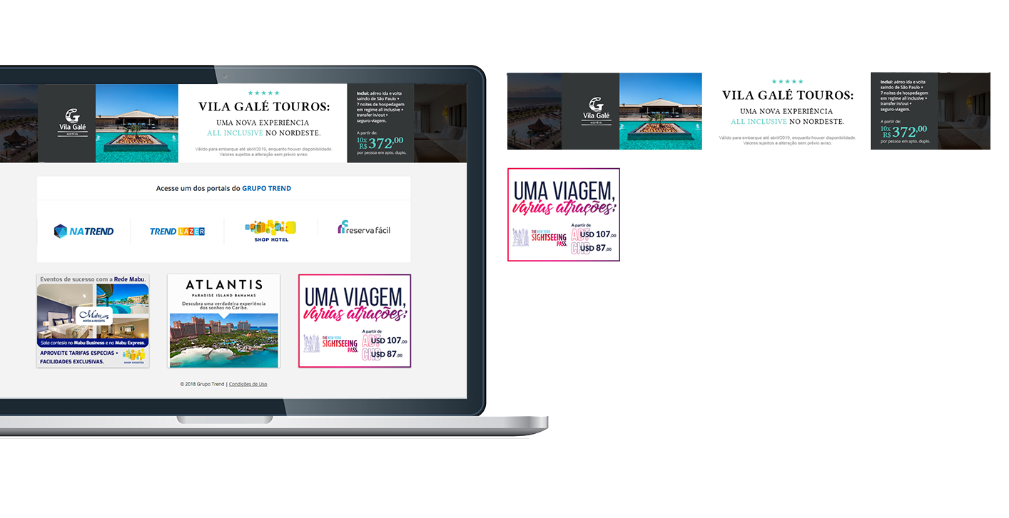

LOGIN PAGE – BANNERS
Fixed top banner
Fixed medium banner
+565,000
Average access per month

Slide 17
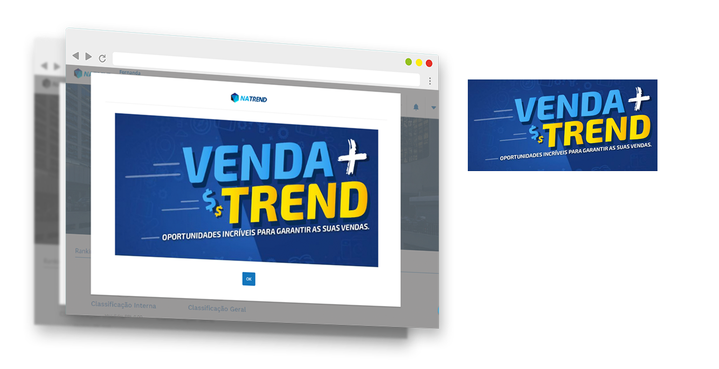
NATREND – BANNER POP-UP
Pop-up banner
+365,000
Average access per month

Slide 18

E-MAIL MARKETING
+23,000
Registered travel agents
+18%
Average e-mail open rate

Slide 19
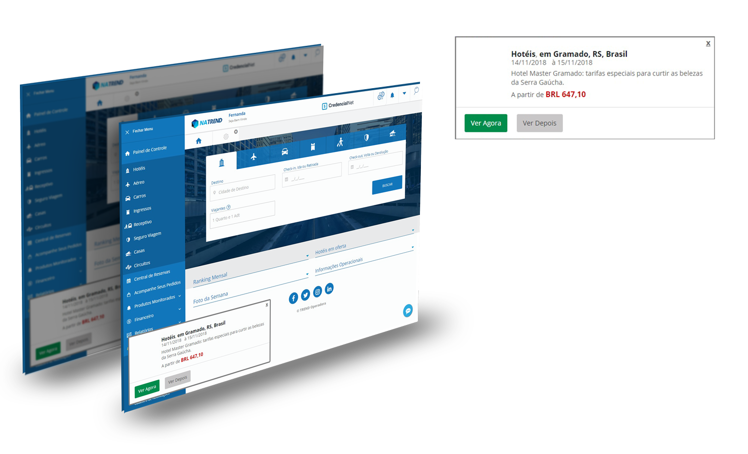
NATREND – PUSH MESSAGE
Push message
+365,000
Average impressions per month
Direct communication with the travel agent at the time of purchase

Slide 20
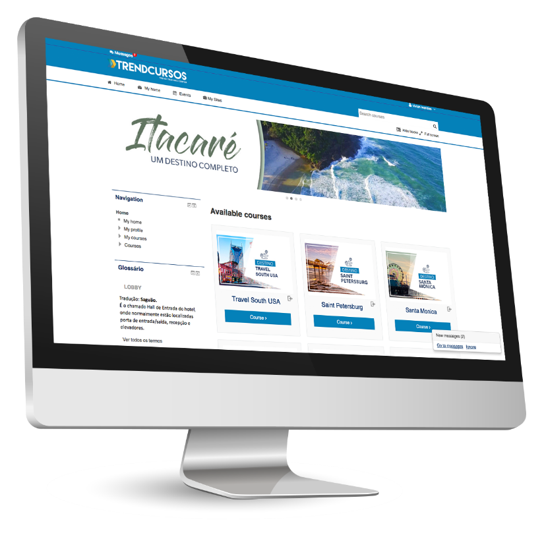
TRENDCOURSES
Qualification training on systems, products, destinations, behavior, languages, web portals and sales, leadership and new business. Podcasting, video lessons and interactive courses are available at this free learning environment.
+6,352
Registered users
+3,400
Accesses per month
+74
Courses

Slide 21
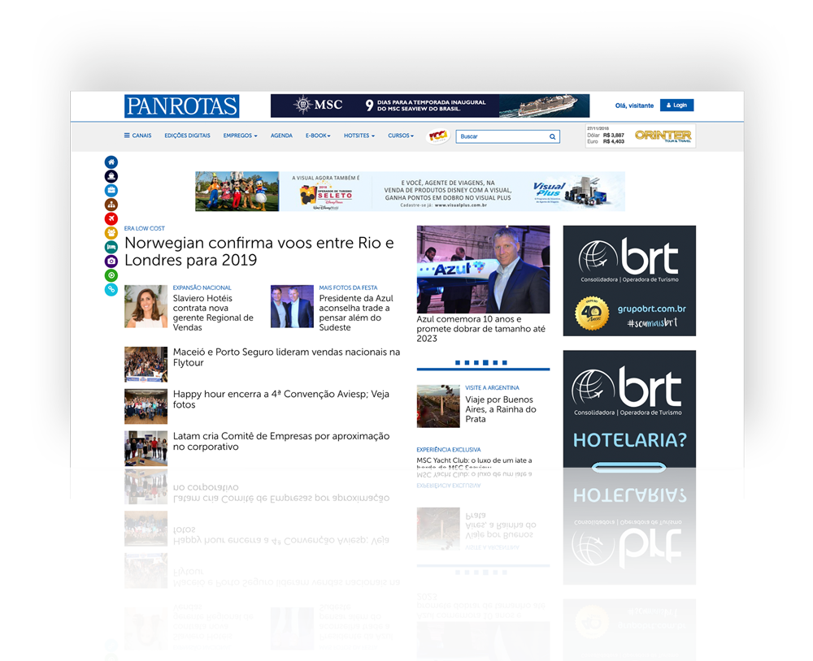
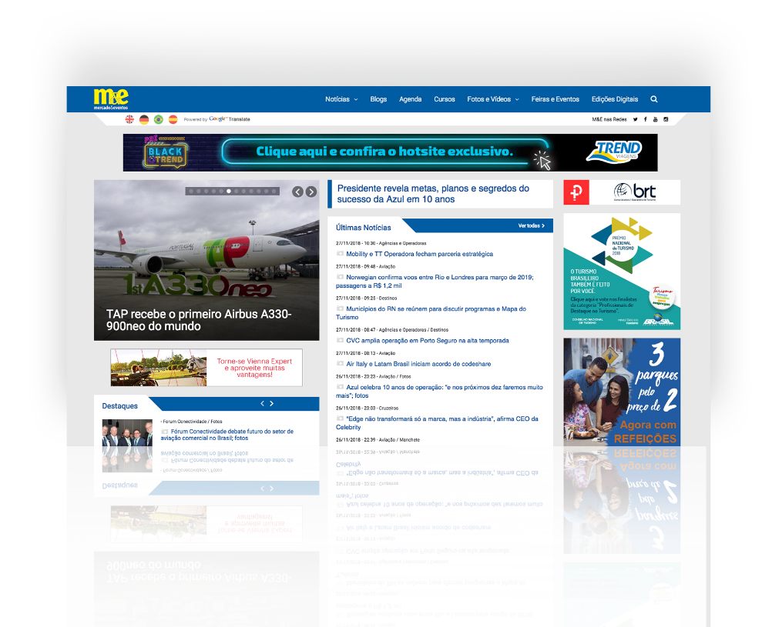
TRADE – MERCADO & EVENTOS AND PANROTAS
Propagation of banners with ads and offers displayed on Panrotas and Mercado&Eventos websites.
PANROTAS +278,000
M&E +360,000
Average access per month
Average access per month

Slide 22
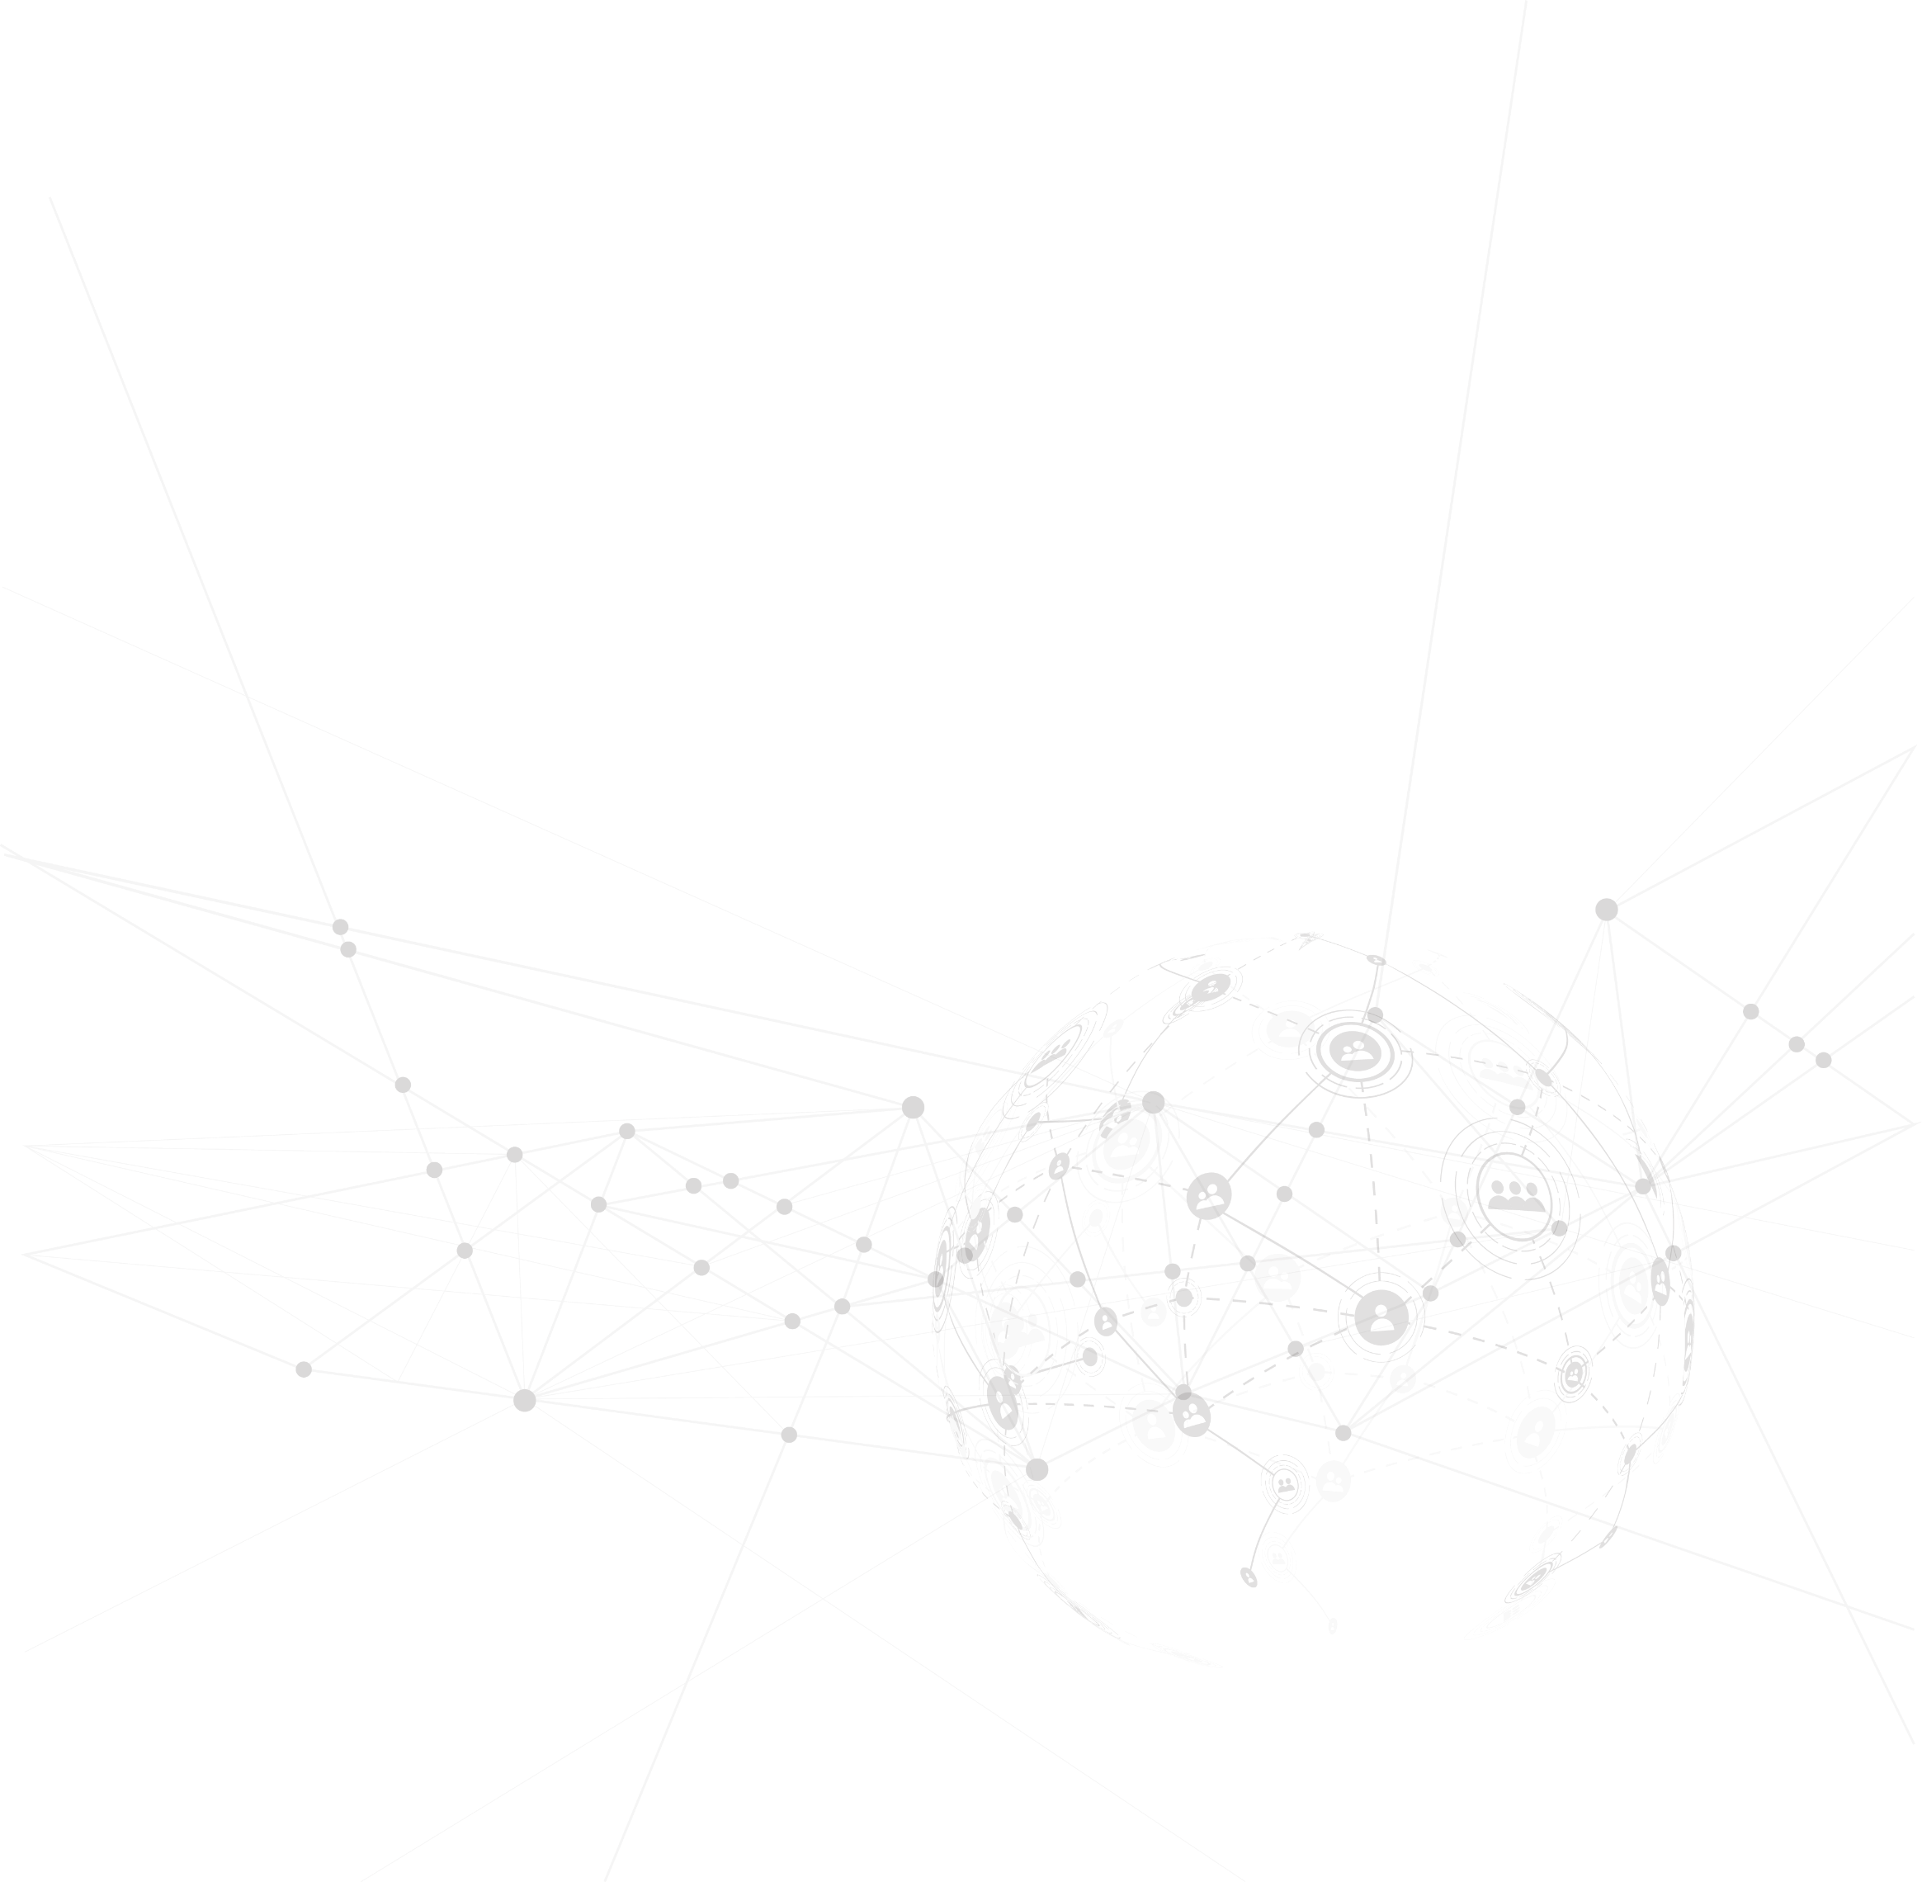

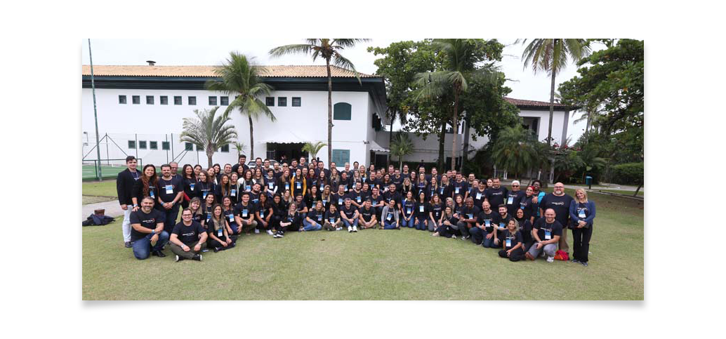
EVENTS – SALES CONVENTION
Participation and propagation of the brand at GRUPO TREND Sales Convention, an event that gathers the TREND Sales team: more than 130 managers and Sales executive from all over Brazil.
+130
Managers and Sales executives

Slide 23

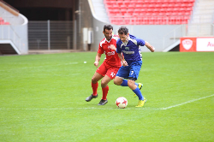
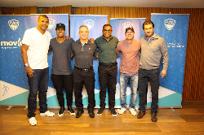
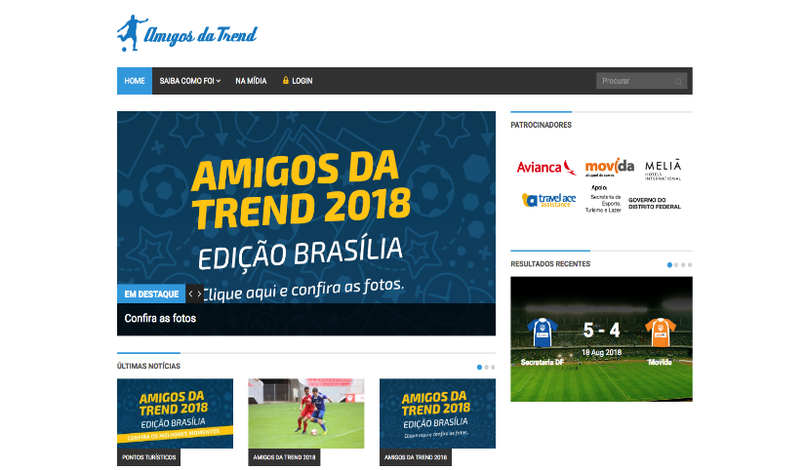
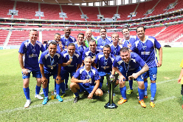
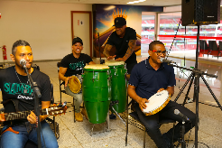
EVENTS – FRIENDS OF TREND
To integrate and to strengthen ties between GRUPO TREND and its main partners: these are the goals of Friends of TREND, a super event that counts on the presence of travel agents, partners, in addition to legendary aces of the Brazilian soccer.

Slide 24
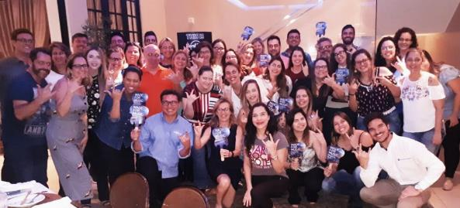
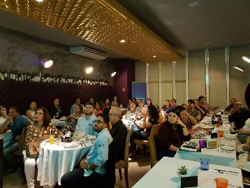
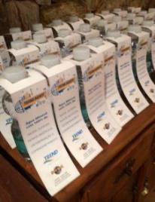
EVENTS – AGENT TRAINING
Training courses given by partners and destinations together with TREND to promote the destination or product. This is an event for up to 40 people aiming to increase sales.
+85
Training courses given in 2018

Slide 25
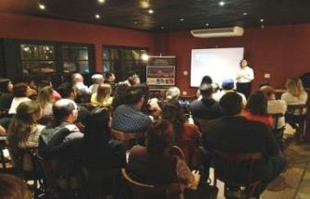
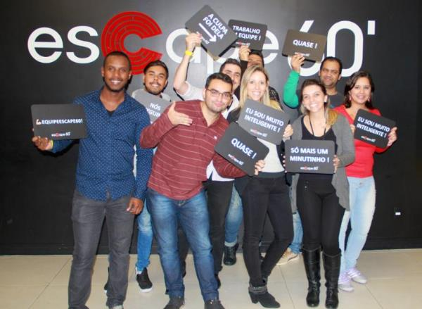
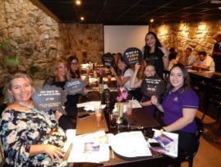
EVENTS – ENGAGEMENT ACTIVITIES
Events with partners of GRUPO TREND and travel agents aiming to encourage networking (partners + Internal Salesforce + Support Service department). Types of events: happy hours, dinners and entertainment activities, such as bowling, kart and Escape 60’.
+103
Events held in 2018

Slide 26
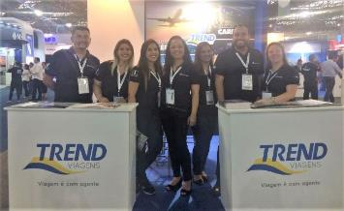
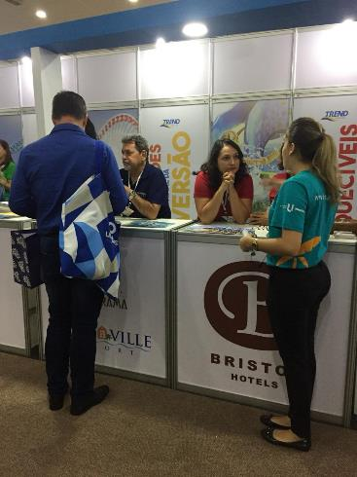
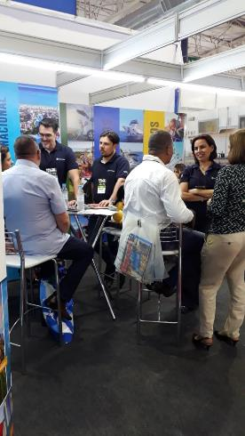
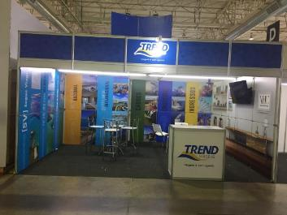
EVENTS – TRADE FAIRS
Participation in the main trade fairs: WTM, Salão Paranaense, Fit Cataratas, ABAV, JPA Travel Market, Festuris, among others.

Slide 27
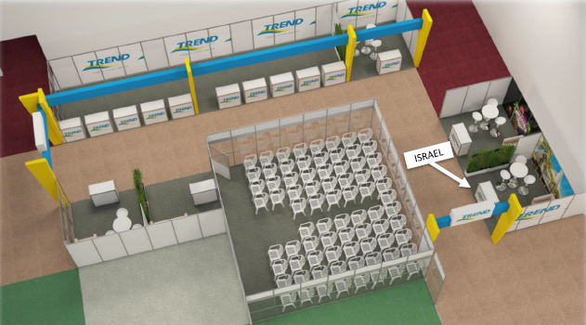
EVENTS – FAIRS
TREND Street at JPA Market Fair.

Slide 28


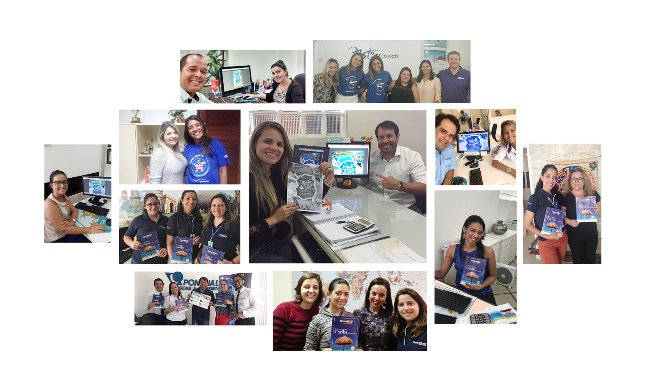
OTHER ACTIVITIES – SALES BLITZ
Exclusive visit to introduce the destination or product to the main travel agents of the market.

Slide 29
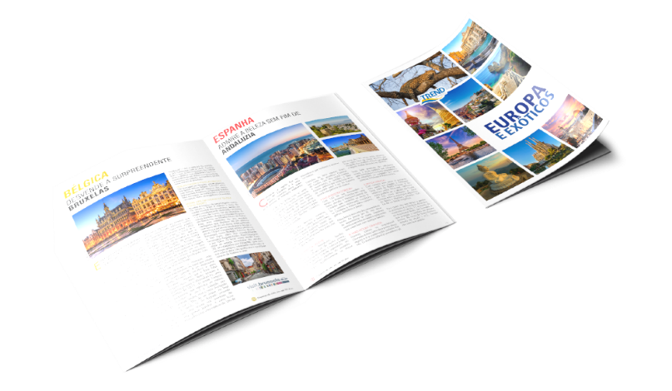




OTHER ACTIVITIES – THEMED WEEKS AND 15 DAYS OF SALES
Exclusive period to boost sales of a destination or partner
Material kit: banner on TREND web portal; banners on Panrotas and Mercado&Eventos web portals; daily e-mail marketing reporting the action during the Themed Week (including exclusive offers for this week, like upgrade or extra benefits); delivery of promotional kits provided by the partners that are participating in; Post event article in Segue Viagem magazine; press release forwarding to the trade about the Themed Week and the advantages that our partners can offer; release on Segue Viagem social media.

Slide 30

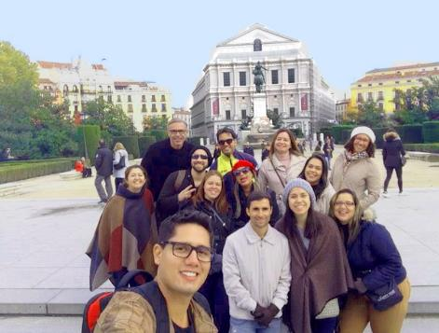
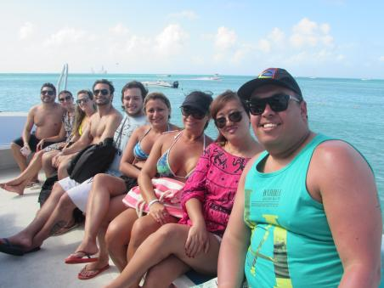
OTHER ACTIVITIES – FAM TOUR
A trip to increase knowledge on the destination allied with a sales campaign.
This is an event for up to 15 travel agents + press invitation.
+18
FAM Tours in 2018

Slide 31

OTHER ACTIVITIES – REVISTA STAY HOME
A magazine exclusively developed to travel agents and guests, bearing everything they need
to know about VHC houses and apartments, in addition to tips on Orlando parks and
destinations in the United States.
Reach:
+1,200 CVC stores all over Brazil
+14,000 travel agencies
Distribution in VHC houses for +15,000 guests
Distribution at trade fairs and events, such as WTM, ABAV and others
Propagation through 54 Sales executives in Brazil

Slide 32
OTHER ACTIVITIES – STAY HOME MAGAZINE
+15,000
Copies
+25,000
Reached people
Bilingual
Portuguese and English

Slide 33
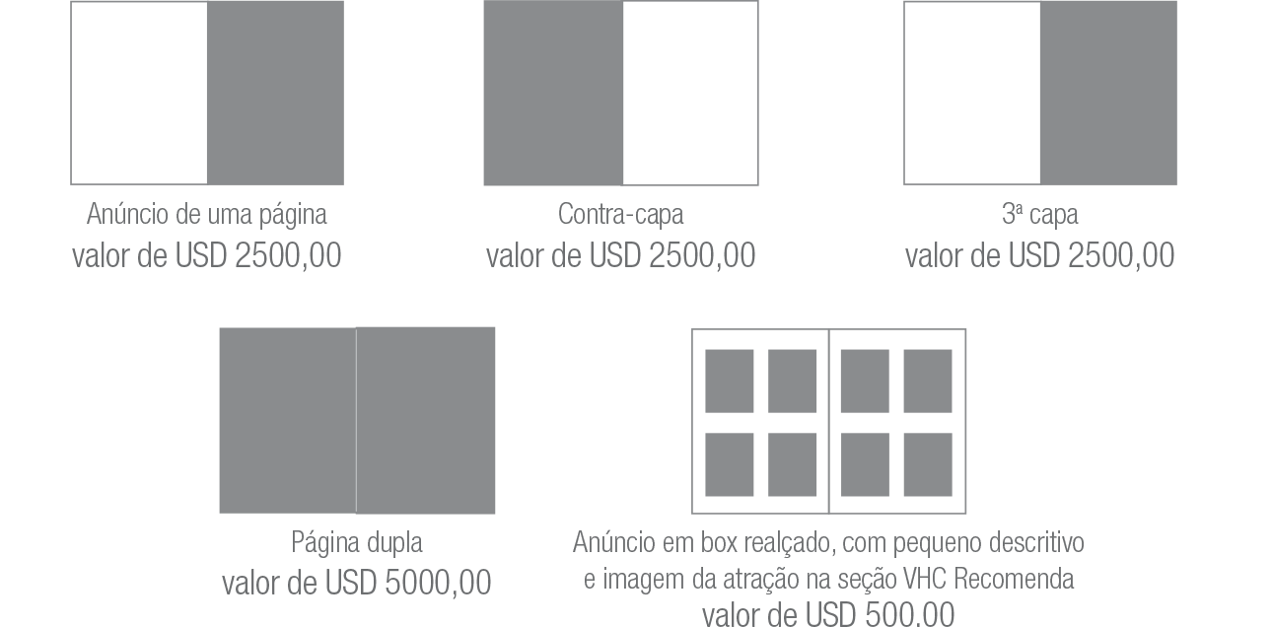
OTHER ACTIVITIES – STAY HOME MAGAZINE
One-page ad
USD 2,500.00
Inside cover ad
USD 2,500.00
3rd cover
USD 2,500.00
Double page
USD 5,000.00
Ad in a highlighted box with a short description and picture of the attraction in the section VHC Recommends
USD 500.00

Slide 34
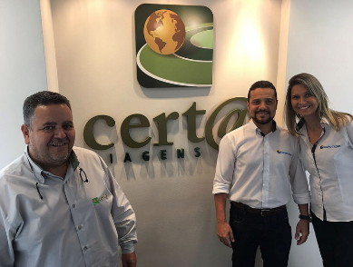
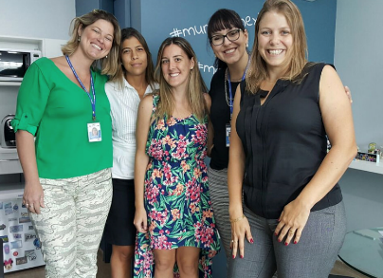
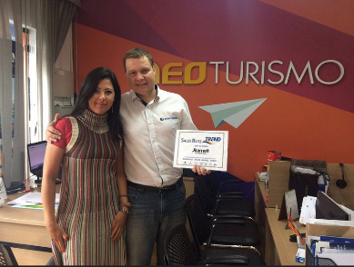
OTHER ACTIVITIES – THEMED WORKSHOP
Training course on destinations and partners intended to the main travel agents from Brazil
Including: TREND product specialists visit travel agencies in Brazil, banners on TREND web portal and trade websites; on-line material kit (post on Segue Viagem Digital and social media, digital brochures, among others).

Slide 35
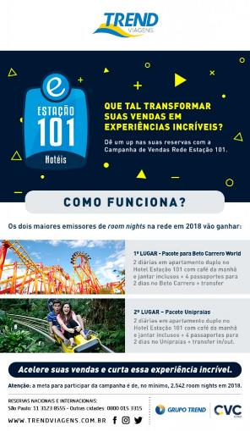


OTHER ACTIVITIES – SALES CAMPAIGN
Campaigns with prizes considering pre-defined goals to:
Internal support team
Sales team
Travel agents

Slide 36




OTHER ACTIVITIES – MKT by TREND
An exclusive program developed to the TOP clients.
HOW DOES IT WORK?
For 90 days, TREND provides a full marketing consultancy service for the agency. The goal is to boost sales of our partners more and more.
Plans already completed:
Toronto
Holland
Visit Florida

Slide 37
OTHER ACTIVITIES – MKT by TREND
An exclusive program developed to the TOP clients of TREND.
TRAVEL AGENCIES ASSISTED:
24 Horas
4 Cantos
Adriana Turismo
Asa Norte
Casablanca
Five Tour
Fox Travel
Grandes Viagens
Greentur
JZ Viagens
La Nave
Nacional Turismo
Pontes Tur
Premier Turismo
Reale Viagens
Sempre Viagem
Travel Class
Trilhas Turismo
Vanilda Viagens

Slide 38
PROPOSAL

Slide 39


CONTACT INFORMATION
Name
Job position
email@grupotrend.com
Phone: 55 xx xxxx-xxxx
Ext.: xxxx

